Slide 1
Market Update, 9/27
Quant Lab
Israel Diego

Slide 2
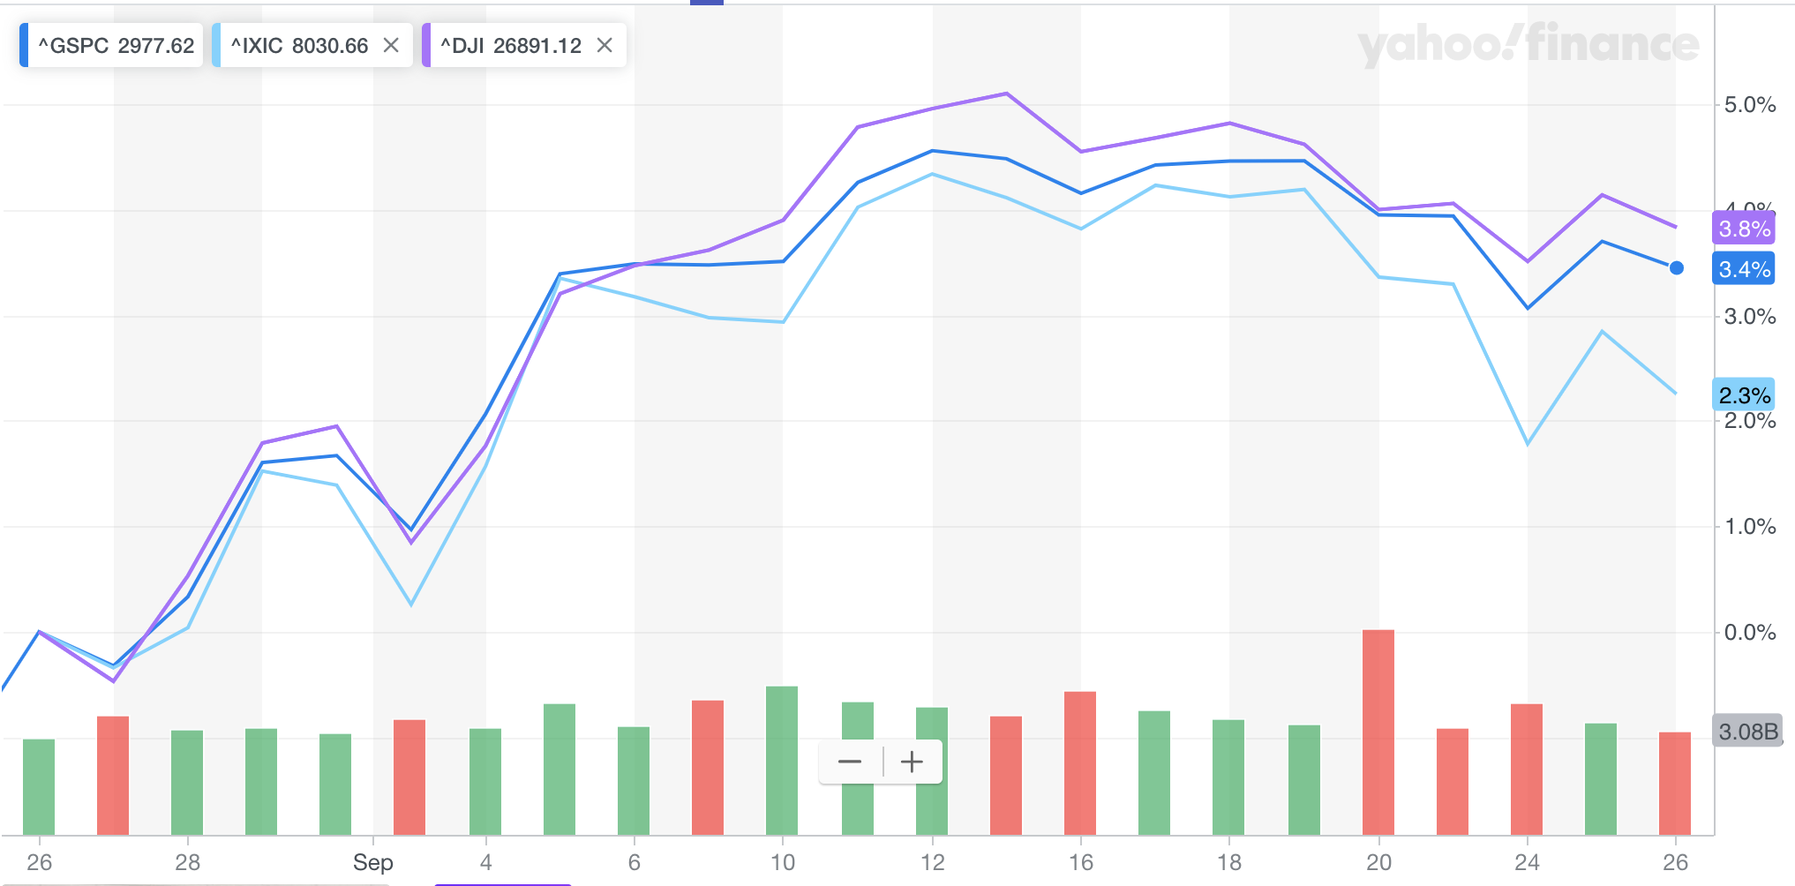
What happened this week?

Slide 3
Sept 23rd:
Germany and France demonstrate weaker manufacturing data, evidence of global economic slowdown. Yields in Europe also dropped.
Netflix down as it struggles in the streaming wars with Disney, Apple, and Amazon.
Sept 24th:
S&P 500 and Nasdaq have worst day in a month. Weaker September consumer confidence report.
Trump criticizes China at UN accusing of intellectual property theft.
Nancy Pelosi makes impeachment announcement. Markets rebounded a bit when Trump announces releasee of transcript from his phone call with Ukraine President, but overall stocks were low.
Nike stock rose more than 5%.
Sept 25th:
Impeachment Inquiry makes headlines. Stocks quickly rise from Trump mentioning that U.S trade deal with China was “closer than we think.” Trade and tariffs have been main mover of the market all year.
Industrials and Consumer Discretionary stocks were up. Utilities and health care closed lower.
Crude oil prices fell after weekly U.S. crude inventories unexpectedly rose. U.S oil production reaches record high, 12.5 million barrels per day. U.S is now largest producer of oil in the world, surpassing Saudi Arabia.
Sept 26th:
Whistleblower report released. U.S unlikely to extend temporary waiver to supplier Huawei. Peloton IPO.

